Slide 1
Rehabilitation, mobility techniques, and IASTM
Brandon Aucker, DC, MS
University of Bridgeport College of Chiropractic
Notes:
DOCTOR PROGRAM

Slide 2
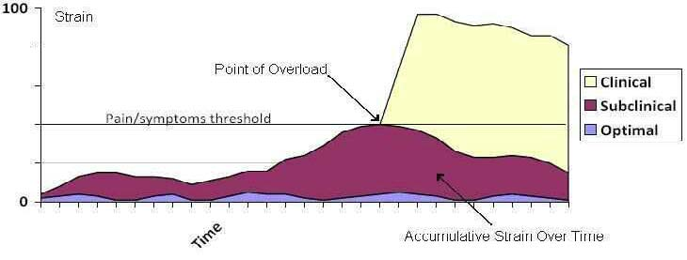
Pain Threshold
Pain vs. dysfunction
Notes:
discuss pain threshold level – chronic pain lowers pain threshold
most chiropractors are good at reducing the pain from clinical to subclinical for a certain duration of time

Slide 3
Basis for Functional Rehabilitation
Without rehab, are we just watering the leaves and starving the roots?
Foundational principles of chiropractic:
Vitalism – the body is self-regulating, self-healing
Holism – whole is greater than the sum of the parts
Notes:
As chiropractors, we help the body heal through adjustments & therapies.
Rehab helps create the optimal environment for healing, restoration, and reinjury prevention
Don’t forget to check the joints above and below (or further away!)

Slide 4
Abnormal Motor Control
Acute phase - painful movements lead to altered movement patterns
These guarded movements predominate and the abnormal movements lead to further injury or neuromuscular re-education
Once the pain has been removed, abnormal motor control is ingrained and retained
Example: fear avoidance behaviors
Notes:
man bending over to tie his shoes has acute flare-up of low back pain
this leads to antalgic posture and abnormal gait
although you calm the fire, the patient still fears his "back going out" while tying his shoes because his body remembers "when I tie my shoes, it causes pain"
Abnormal motor control is developed leading to altered movement patterns

Slide 5
THE 80% - why rehab?
Pain vs. dysfunction
Notes:
Although this shows strain of a muscle, I thought it was a good schematic for showing the pain/symptoms threshold and if we reverse it, how rehab works to lower chance of injury as well as subclinical injury/pain levels.
Even though we relieve clinical pain, subclinical pain can further ingrain abnormal motor control and create new problems or allow re-aggravation of old ones

Slide 6
Basic mechanisms of injury
INTRINSIC
Overuse – repetitive microtrauma
Dynamic overload of tissue capabilities
Inflexibility – poor biomechanics
Structural vulnerability – disease process, previous injury
Rapid Growth – cancer, growth spurt
EXTRINSIC
Contact
Impact

Slide 7
Manipulation without rehab = negligence (Malpractice?)
Joint restrictions decrease motion causing static stability
Manipulation restores mobility, thus disconnect between stable muscles and mobile joints and brain – static stability lost
Rehab promotes dynamic stability, restores tensegrity model
Notes:
Tensegrity - structures stabilize themselves by balancing the counteracting forces of compression and tension

Slide 8
Wound healing phases
Inflammatory
0-7 days
Proliferative
5-21 days
Maturation
20 days to up to 2 years

Slide 9
Inflammatory phase
Clot formation
Fibrin, fibronectin, and collagen deposited – type III
Migration of PMNs
Proteolytic enzymes for wound debridement
Pericytes and fibroblasts divide
pain ≠ inflammation
Notes:
Pericytes - contractile cells that wrap around the endothelial cells that line the capillaries and venules throughout the body.
Swelling causes pain – if something is painful, it may not be inflamed (allodynia, nociceptors irritated)

Slide 10
Proliferative phase
Migration of endothelial cells, myofibroblasts, and fibroblasts
new capillaries formed – angiogenesis
Myofibroblasts and fibroblasts align to new capillaries
Collagen type III differentiates to type I
Myofibroblasts contract

Slide 11
MATURATION PHASES
Macrophage population decreases sharply
Definitive capillary network
Myofibroblasts and fibroblasts populations decline
Tensile strength increases

Slide 12
Pain ≠ inflammation - Tendinosis
Degeneration of tendon
Caused by chronic loading
Inadequate repair
Decreased collagen and matrix production
Tenocyte death (fibroblasts lays down weak matrix)
Ultimately leads to rupture

Slide 13
Modifications of healing response
NSAIDS – decrease inflammation, stop repair process (skip replication phase and stimulate synthesis)
E-stimulation – High volt galvanic (300-400ma, 50-100msec)
Massage – increase blood flow, tissue relaxation, scar breakdown
Ultrasound – increase blood flow, tissue relaxation, scar breakdown
Ice – reduce swelling, promote blood flow, allows movement (speeds healing), decreases metabolism
Notes:
HVG – penetrates deeper, direct simulation of deep nerves and muscles, decrease pain, increase joint mobilization, increase peripheral circulation, decrease spasm

Slide 14
Holistic Treatment
Restore physiological motion to the joints
Remove fascial adhesions and myofascial trigger points to allow proper muscle function
Neuromuscular rehab to reinforce proper motor movement patterns
Notes:
Generally, we are forcing the body back into the proliferative phase to promote the healing process

Slide 15
Holistic Treatment
Restore physiological motion to the joints
Remove fascial adhesions and myofascial trigger points to allow proper muscle function
Neuromuscular rehab to reinforce proper motor movement patterns

Slide 16
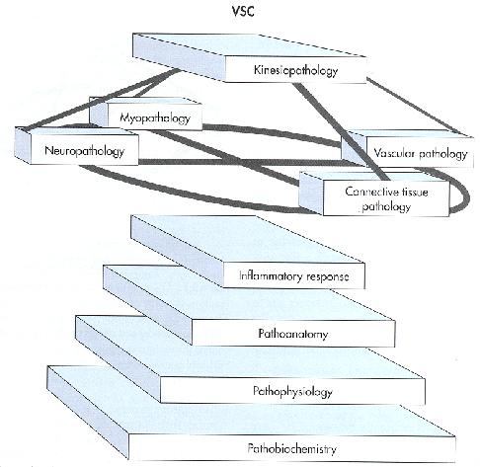
SUBLUXATION COMPLEX
Kinesiological
Neurological
Myological
Connective tissue
Inflammatory
Lantz, CA. A Critical Look at the Subluxation Process. JMPT 1989 (Apr)
Notes:
Almost 30 years ago, researchers realized there was more to a subluxation than just a simple "joint restriction"
Stephen Perle - the web that has no weaver adapted from TJ Kaptchuk.

Slide 17
The web is depicted as circular with perfect structure and function. Every strand placed perfectly to create optimal tensegrity.

Slide 18
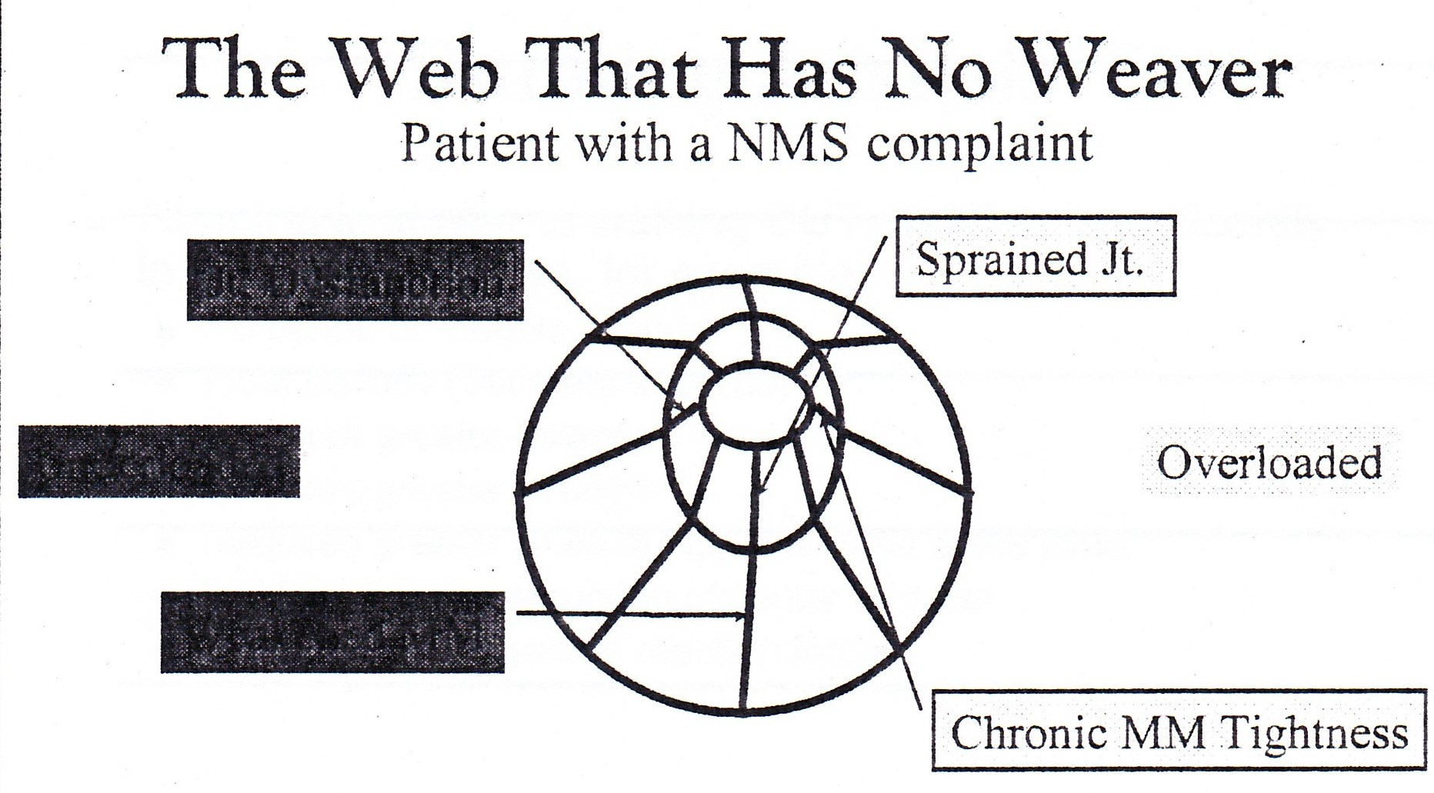
Joint Dysfunction
Underloaded
Weakened MM
Notes:
Say we develop a joint dysfunction which is caused by overloaded tissues. The web is now improperly balanced. As chiropractors, we must correct all the elements of a subluxation complex to re-establish proper biomechanics.

Slide 19
Comparison of spinal manipulation methods and usual medical care for acute and subacute low back pain: a randomized clinical trial.
"Manual-thrust manipulation provides greater short-term reductions in self-reported disability and pain compared with usual medical care. 94% of the manual-thrust manipulation group achieved greater than 30% reduction in pain compared with 69% of usual medical care."
SCHNEIDER ET AL (2015), SPINE

Slide 20
MANUAL AND INSTRUMENT APPLIED CERVICAL MANIPULATION FOR MECHANICAL NECK PAIN: A RANDOMIZED CONTROLLED TRIAL
• A single application of MAM increased rotation and lateral flexion movements and decreased pain levels in people with mechanical neck pain.
• A single application of IAM increased hand grip strength on the contralateral side to manipulation.
• There was no change in PRESSURE POINT TENDERNESS following either type of manipulation.
• Following 21 MAMs and 22 IAMs, there were no moderate or severe adverse events and 2 mild adverse events reported in this trial.
GORRELL ET AL (2016), J Manipulative Physiol Ther.

Slide 21
The Neuromuscular Response to Spinal Manipulation in the Presence of Pain.
Muscle responses occurred in 61.6% ± 23.6% of the EMG locations in the asymptomatic group and 52.8% ± 26.3% of the symptomatic group.
Muscle activity onset delays were longer for the symptomatic group at every EMG location. . .
The results revealed trends that indicate participants with low back pain have less muscle responses, and when muscle responses are present they occur with longer onset delays following the onset of a manipulation impulse.
CURRIE ET AL (2016), J Manipulative Physiol Ther.

Slide 22
Holistic Treatment
Restore physiological motion to the joints
Remove fascial adhesions and myofascial trigger points to allow proper muscle function
Neuromuscular rehab to reinforce proper motor movement patterns

Slide 23
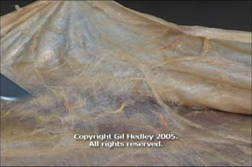
Fascia
Biomechanical fabric
that surrounds everything
Extracellular matrix
Collagen, reticulin, Elastin, collagen fiber, fluid, proteins
Connective tissue
Osteoblasts, chondroblasts, osteoclasts, chondroclasts
Is the body composed of 600 muscles or one muscle in 600 fascial compartments? – Anatomy Trains
Notes:
normally pliable
With any trauma, stress (emotional or physical), fascia becomes rigid and restricted due to fascial adhesions

Slide 24
Notes:
Fascia has 10x more afferent nerves than other tissues

Slide 25
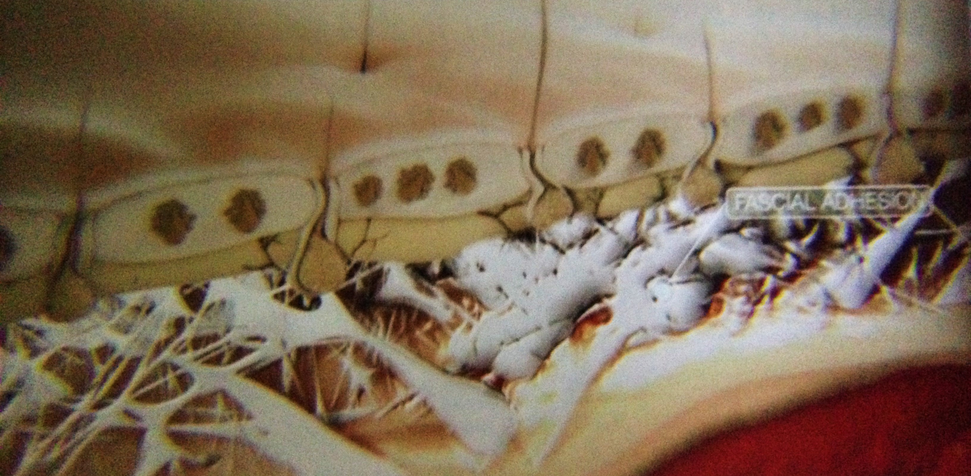
Notes:
Myofascial trigger point forms – fascia adheres to itself and forms cross fibers

Slide 26
Myofascial Release Techniques
IASTM (Instrument assisted soft tissue mobilization)
Cyriax
Trigger point therapy
Strain/counter-strain
Pin and stretch
Self myofascial release (foam roller, mobility tools, pir)

Slide 27
IASTM & Cyriax
Breaks down fascial adhesions
Stretches connective tissues
Inhibits chronic muscle holding pattern to allow improved sensory input
Immediate increase of blood flow, proposed angiogenesis
Alters/inhibits spinal reflex activity (facilitated segment)
Microtrauma initiates inflammation process and histamine response Increasing cellular activity (fibroblasts and mast cells)

Slide 28
IASTM
Instruments allow deeper penetration than fingers
Quicker, improved outcomes
Aims to:
Cause healing (stimulate inflammation) through traumatic hyperemia
Break up adhesions
Increase fibroblast recruitment and replication
Increase fibroblast activation – collagen synthesis

Slide 29
IASTM Technique
Lubricate skin
Glide instrument along skin at various angles (assessment)
Break up adhesions (vibration feedback through instrument)
BRUISING: Forewarn patient due to localized microtrauma, bruising may occur. This is natural process of breaking-up adhesions. It is called petechiae and looks like a rash. This usually resolves within 3 days

Slide 30
contraindications
RED FLAGS:
Open wound – suture site
Unhealed fractures
Thrombophlebitis
Uncontrolled hypertension
Intolerance/non-compliance/hypersensitivity
Hematoma
Osteomyelitis
Myositis ossificans
Hemophilia

Slide 31
contraindications
YELLOW FLAGS:
Anti-coagulant medications
Cancer
Varicose veins
Burn scars
Acute inflammatory conditions
Kidney dysfunction
Inflammatory condition secondary to infection
Pregnancy (ligament laxity)
Osteoporosis or acute Rheumatoid arthritis

Slide 32
Common usage
Epicondylitis/osis
Carpal Tunnel Syndrome
Plantar Fasciitis/heel pain/Achilles tendinitis/osis
Rotator cuff tendinitis/osis
Patellar tendinitis/osis
DeQuervain’s Syndrome
Chronic and Acute* sprains/strains
IT Band Syndrome
Chronic (non-acute) bursitis
Myofascial pain/restrictions
Notes:
ANY TENDINITIS/OSIS

Slide 33
TREATMENT phases
Inflammatory Stage (24-48 hours):
Exudates move into area along with macrophages and histiocytes for debridement of tissues
IASTM initiates this stage to allow healing and remodeling
Granulation Stage
Increased vascularity and capillary budding
Fibroblastic Stage (5-8 days):
Increased proliferation of fibroblasts
Accelerated collagen production
Maturation Stage (up to one year):
Hydrostatic bonds converted to stronger covalent bonds
Scar shrinkage secondary to myofibroblasts

Slide 34
Acute vs. chronic
Acute:
Superficial strokes, slower rate, less duration
Chronic:
Deeper strokes, faster rate, longer duration
In case of extreme bruising: DO NOT REPEAT IASTM

Slide 35
Fascial Manipulation® for chronic aspecific low back pain: a single blinded randomized controlled trial
Patients receiving Fascial Manipulation® showed statistically and clinically significant improvements at the end of care for all outcomes, in the short (RMDQ, VAS, BPI) and medium term for VAS and BPI compared to manual therapy.
BRANCHINI ET AL (2016), F1000RESEARCH.
Notes:
VISUAL ANALOGUE SCALE, BRIEF PAIN INVENTORY

Slide 36
Acute Effects of Instrument Assisted Soft Tissue Mobilization for Improving Posterior Shoulder Range of Motion in Collegiate Baseball Players
A significant group-by-time interaction was present for GH horizontal adduction ROM with the IASTM group showing greater improvements in ROM (11.1°) compared to the control group (-0.12°) (p<0.001). A significant group-by-time interaction was also present for GH internal rotation ROM with the IASTM group having greater improvements (4.8°) compared to the control group (-0.14°) (p<0.001).
LAUDNER ET AL (2014), IJSPT.
Notes:
International journal of sports physical therapy
17 in testing group – examination plus one treatment via IASTM
18 in control group – examination only

Slide 37
Spinal manipulative therapy, Graston technique® and placebo for non-specific thoracic spine pain: a randomized controlled trial
This study indicates that there is no difference in outcome at any time point for pain or disability when comparing SMT, Graston Technique® or sham therapy for thoracic spine pain, however all groups improved with time.
CROTHERS ET AL (2016), CHIROPRACTIC & MANUAL THERAPIES.

Slide 38
TREATMENT CONSIDERATIONS
Direction – perpendicular, parallel, or diagonal to fibers
Amplitude – large/small
Rate – rapid/slow
Pressure – superficial/deep
Contact point
Angle – generally 30° to 60°
Frequency – Once every three days (twice per week) *patient specific*
Treatment duration: Usually 4 to 8 session *patient specific*
Treatment progression: gentle → more aggressive localized → generalized

Slide 39
ASSESSMENT & TREATMENT METHODS
SWEEP – moving in one direction at the same rate
Scanning, edema reduction
FANNING – moving in arched path at different rates
Localized scanning
BRUSHING – superficial linear strokes, small amplitude
Mobilization of superficial fascia, desensitization
STRUMMING – perpendicular to fiber, small amplitude
Mobilization of specific restrictions
J-STROKE, SWIVEL, SCOOPING
Notes:
BRUSH BEFORE STRUMMING

Slide 40
Specialized tests and treatments
Carpal Tunnel Syndrome/Peripheral Neuropathies
Median Nerve Tension Test
Ulnar Nerve Tension Test (patient performed)
Iliotibial Band Syndrome
Glute medius, glute minimus, TFL, adhesion anterior and posterior to IT Band
SI joint, lateral gluteal, groin pain
Maigne’s point/Thoracolumbar Syndrome
Notes:
BRUSH BEFORE STRUMMING

Slide 41
Self MFR: Foam Roller, lacrosse ball
Breaks down fascial adhesions
Stretches connective tissues
Inhibits chronic muscle holding pattern to allow improved sensory input
Immediate increase of blood flow, proposed angiogenesis
Alters/inhibits spinal reflex activity (facilitated segment)
Microtrauma initiates inflammation process and histamine response Increasing cellular activity (fibroblasts and mast cells)

Slide 42
Acute Effects of Self-Myofascial Release Using a Foam Roller on Arterial Function
Acute effect of foam roller on arterial stiffness and vascular endothelial function
Brachial-ankle pulse wave velocity (BAPWV), blood pressure, heart rate, and plasma nitric oxide measured before and 30 minutes after trials
BAPWV significantly decreased and plasma NO significantly increased after SMR – no sig difference in control trial
OKAMOTO ET AL (2014), JOURNAL OF STRENGTH AND CONDITIONING RESEARCH.
Notes:
10 healthy young adults were both SMR and control
Nitric oxide allows fibroblasts to differentiate type III collagen into type I collagen

Slide 43
Is Self Myofascial Release an Effective Pre-exercise and Recovery Strategy? A Literature Review
9 RCT EXAMINED SMR AS PREEXERCISE, MAINTENANCE, AND RECOVERY AND TREATMENT TOOL
5 STUDIES NOTED INCREASED ROM
2 STUDIES SHOWED INCREASE IN VERTICAL JUMP HEIGHT AND MAXIMAL FORCE OUTPUT
THREE STUDIES SHOWED DECREASED MUSCLE SORENESS/FATIGUE
SCHROEDER ET AL (2015), AMERICAN COLLEGE OF SPORTS MEDICINE.
Notes:
Very heterogenous mix of different exercise protocols, differing number and timing of foam rolling, and different outcomes measured

Slide 44
The Effects of Self-Myofascial Release Using a Foam Roll or Roller Massager on Joint Range of Motion, Muscle Recovery, and Performance: A Systematic Review
14 STUDIES MET INCLUSION CRITERIA
SMR 30 SECONDS-1 MINUTE, 2-5 SESSIONS ENHANCED JOINT FLEXIBILITY AS A PRE-EXERCISE WARMUP AND COOL DOWN
SMR after high intensity exercise attenuates decrements in lower extremity muscle performance and reduces perceived pain
Short bouts of smr does not enhance or negatively affect muscle performance but changes perception of fatigue
CHEATHAM ET AL (2015), IJSPT.
Notes:
INTERNATIONAL JOURNAL OF SPORTS PHYSICAL THERAPY
Alteration of viscoelastic and thixotropic property of fascia, increases in intramuscular temperature and blood flow due to friction, alterations of muscle-spindle length or stretch perception, and mechanical break-down of scar tissue
SMR increases blood flow and blood lactate removal, edema reduction, and oxygen delivery to the muscle
Suggestion of smr influence on connective tissue rather than muscle tissue may explain altered perception of pain without change in performance (10x more afferents in fascia)

Slide 45
Holistic Treatment
Restore physiological motion to the joints
Remove fascial adhesions and myofascial trigger points to allow proper muscle function
Neuromuscular rehab to reinforce proper motor movement patterns

Slide 46
Abnormal Motor Control
Acute phase - Painful movements lead to altered movement patterns
These guarded movements predominate and the abnormal movements may lead to further injury or neuromuscular re-education
Once the pain has been removed, abnormal motor control is ingrained and retained
Example: fear avoidance behaviors

Slide 47
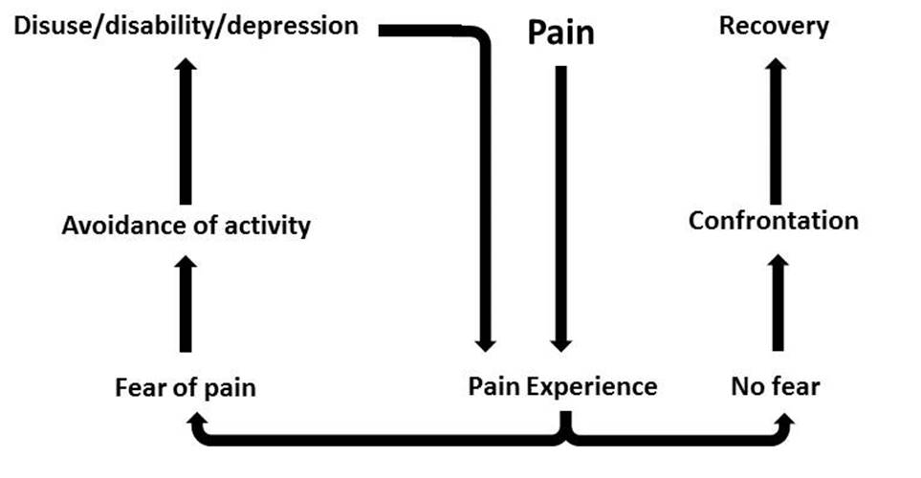
Abnormal Motor Control
Rehab
Pain Experience
CMT & MFR
Notes:
man bending over to tie his shoes has acute flare-up of low back pain
this leads to antalgic posture and abnormal gait
although you calm the fire, the patient still fears his "back going out" while tying his shoes because his body remembers "when I tie my shoes, it causes pain"
Abnormal motor control is developed leading to altered movement patterns

Slide 48
Vladimir Janda (1928 – 2002)
Neurologist and physiatrist
Polio as a teen fueled his drive for physical medicine
Known for concepts of musculoskeletal imbalance
Joints, muscles, and nervous system are functionally integrated so timing or recruitment pattern of synergists = key to improvement
Dysfunction can lead to:
Successful compensation from another system or normal adaptation
Long-term adaptation by one or more subsystem
Injury to one or more components of subsystem or pathological adaptation

Slide 49
Key areas of proprioception
Articular receptors contribute to postural reflexes, joint stabilization, and motor control
Three key areas for maintenance of posture:
Sole of foot
Altered feedback = altered gait and patterns of muscle activation
Stimulation improves kinesthesia and postural sway
Sacroiliac joint
Transmits forces between lower extremity and trunk
Commonly source of dysfunction in patients with chronic LBP
Cervical spine
Chronic cervical dysfunction leads to balance deficits

Slide 50
POSTURAL MUSCLES
TIGHTNESS PRONE/ FACILITATED
Internal rotators, Adductors, Pronators, Flexors
GASTROC/SOLEUS
TIBIALIS POSTERIOR
HAMSTRINGS
ILIOPSOAS
TFL
RECTUS FEMORIS
SHORT HIP ADDUCTORS
SARTORIUS
PIRIFORMIS
LUMBAR ERECTOR SPINAE
QUADRATUS LUMBORUM
PECTORALIS MAJOR
UPPER TRAPEZIUS
LEVATOR SCAPULA
SCALENES
SCM

Slide 51
PHASIC MUSCLES
WEAKNESS PRONE/ INHIBITED
external rotators, Abductors, supinators, extensors
FIBULARIS
ANTERIOR TIBIALIS
VASTUS MEDIALIS & LATERALIS
GLUTEI
RECTUS ABDOMINIS
SERRATUS ANTERIOR
RHOMBOIDS
LOWER TRAPEZIUS
DEEP CERVICAL FLEXORS
EXTENSORS OF UPPER LIMBS

Slide 52
UPPER CROSSED SYNDROME
SKELETAL ABNORMALITIES:
FORWARD HEAD POSTURE, FORWARD ROUNDED SHOULDERS
TIGHTNESS: WEAKNESS:
COMMON CONDITIONS:
PECTORALS
UPPER TRAPEZII
LEVATOR SCAPULAE
SCM
DEEP NECK FLEXORS
RHOMBOIDS
LOWER & MID TRAPEZIUS
SERRATUS ANTERIOR
ROTATOR CUFF IMPINGEMENT
SHOULDER INSTABILITY
BICEPS TENDINOSIS
THORACIC OUTLET SYNDROME
HEADACHES
NECK PAIN
PERIPHERAL NEUROPATHY

Slide 53
LOWER CROSSED SYNDROME
SKELETAL ABNORMALITIES:
ANTERIOR PELVIC TILT, HYPERLORDOSIS, COXAFEMORAL FLEXION
TIGHTNESS: WEAKNESS:
COMMON CONDITIONS:
LUMBAR ERECTOR SPINAE
HIP FLEXORS (ILIOPSOAS, TFL, RECTUS FEMORIS)
QUADRATUS LUMBORUM
ABDOMINALS (RECTUS & TRANSVERSUS)
GLUTEALS (MAX, MIN, MED)
HAMSTRING STRAINS
ANTERIOR KNEE PAIN
LOW BACK PAIN

Slide 54
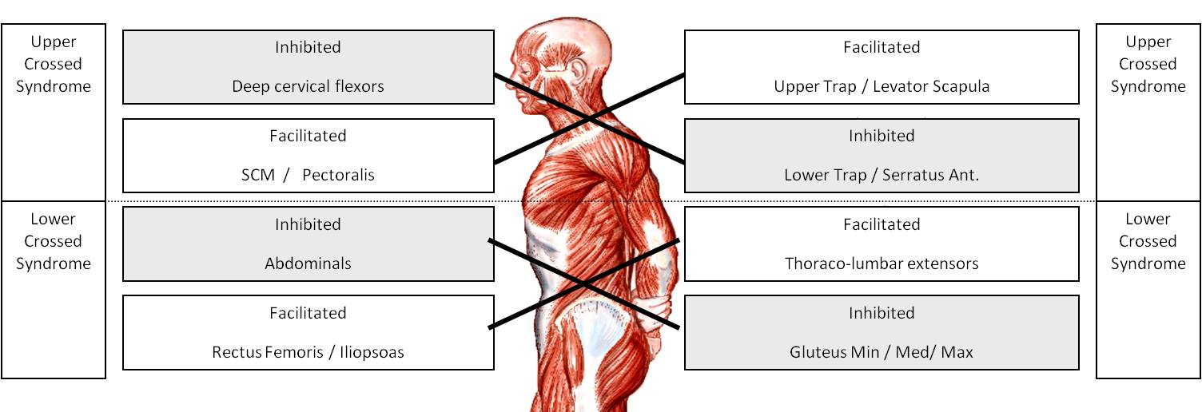
LAYER SYNDROME

Slide 55
Janda’s approach
Normalize the afferents from the periphery
CMT
Restore muscular balances
MFR, IASTM
Increase afferent input, facilitating reflex stabilization
Rehab/neuromuscular re-training
Improve endurance in coordinated movement patterns
Proper form, no pain!
Notes:
Easily and accurately assess patient for muscular imbalances
Hip extension
Hip abduction
Trunk curl-up
Cervical flexion
Push-up
Shoulder abduction

Slide 56
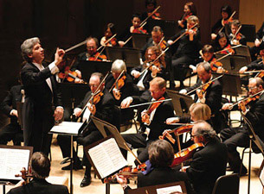
The body is an orchestra!
Stability
The ability of joint/joint complex to maintain position while movement occurs in a different area
Mobility
The ability of joint/joint complex to move unrestricted through full ROM
Flexibility
The ability of a muscle/muscle group to elongate
Motor control is a balance of all of these concepts
Notes:
Mobility has movement component

Slide 57
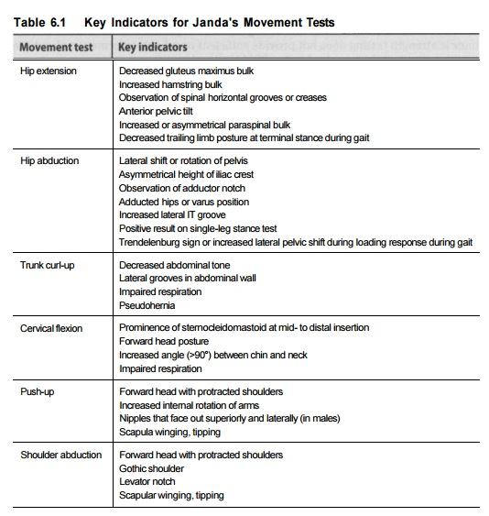
Assessment and Treatment of muscle imbalance: The Janda Approach
Page et al (1967)
Notes:
Hip extension – patient lies prone with arms at sides and feet hanging over edge of table. Normal movement pattern – hamstrings, glute max, contralateral ES, ipsi ES. Most common faulty sign: overactivation HS and ES.
Hip abduction – patient side posture with arms in front, bottom knee bent. Normal movement pattern – abduction without hip elevation or trunk rotation. Most common fault signs: hip hike or concurrent hip flexion.
Trunk curl-up – patient supine with knees bent at ~90 degrees and hands on thighs. Normal movement pattern – abdominal contraction, flexion T/S, flattening L/S, posterior pelvic tilt. Most common faulty sign: overactivation hip flexors (decreased heel pressure or minimal curling upper trunk).
Cervical flexion – patient supine, arms at side, head neutral. Normal movement pattern – cervicocranial flexion curling to chest. Most common faulty sign: overactivation of SCM and anterior scalenes causing chin-jut; bulkiness in SCM at rest insists SCM dominance
Push-up – patient push up position. Normal movement pattern – scapulae abduct and upwardly rotate during push up. Most common faulty signs: serratus ant. Weak – winging or excessive adduction scap; overactive upper traps & lev. Scap – shoulder shrug or levator notch
Shoulder abduction – patient seated, elbows bent. Normal movement pattern – abduction, scapular upward rotation, scapular elevation. Most common faulty signs: elevation of shoulder before 60 degrees abduction (upper trap, lev scap overactivation, pathology); shoulder shrug or levator notch; contralateral lateral side bend to initiate movement (severe weakness in shoulder cuff, deltoid or overactivity QL)

Slide 58
Why warm up?
Injury prevention due to physical and mental “awakening”
improved blood flow to muscle and tendons
awakening of neural connections
Dynamic stretching provides performance improvements, static stretching and pnf does not provide any improvements¹
short-duration static stretching warm-up has no effect on power outcomes; and passive heating/cooling is a largely ineffective warm-up mode²
Acute effects of muscle stretching on physical performance, range of motion, and injury incidence in healthy active individuals: a systematic review.
A systematic review of the effects of upper body warm-up on performance and injury.
Notes:
if more troops are awake at the time of battle, you will have less casualties and better recruitment

Slide 59
Generalized Warm-up Routine:
Upper Body:
Neck – look left and right (3x each side, 3-5 second hold)
Neck – head rolls (3-5 passes each direction)
Arms – cross arm swing (10-15 seconds)
Arms – open and close gate (10-15 seconds)
Arms – shoulder circles (each direction, 10-15 seconds)
Trunk twists (10-15 seconds)
Lower Body:
Hips – hip rotation (5-10 passes each direction)
Knees and ankles – knee rotation (5-10 passes each direction)
Ankles/calves – heel-toe rockers (20-30 seconds)
Notes:
Followed by:
200m-400m run
Air squats – 10
Pushups (may be modified) – 10
Hip thrusters/glute bridge – 15 both feet planted, then 10 one-legged

Slide 60
When do we start rehab?
IMMEDIATELY!
LATERAL CORTICOSPINAL TRACTS
main motor tracts for voluntary muscle activity
80-90% decussate to contralateral side
10-20% do not decussate
Therefore, in theory, by voluntarily moving the unaffected side, we’re rehabilitating the affected side to some degree
Notes:
Physical Medicine and Rehabilitation Board Review, Third Edition
By Dr. Sara J. Cuccurullo, MD

Slide 61
The acute effects of targeted abdominal muscle activation training on spine stability and neuromuscular control
As a group, 5 min of ADIM training did not change spine stability during dynamic movement.
However, those who were most successful in improving TrA activation with a 5-min ADIM training session showed the greatest improvements in local dynamic spine stability after training. As such, dynamic spine stability in some individuals may benefit from ADIM training.
SOUTHWELL ET AL (2016), Journal of NeuroEngineering and Rehabilitation
Notes:
abdominal drawing-in maneuver (ADIM) standing – 13 “healthy” participants – once before and once after training
Indwelling and surface EMG and 3D kinematic data recorded during all trials
What does this tell us? Some people are more fit/have more body awareness than others. 5 minutes in one session may not be enough to rehab those that are deconditioned.

Slide 62
Overhead Deep Squat Performance Predicts Functional Movement Screen Score
Individuals categorized as low performance as a result of the DS test had lower adjusted FMS™ composite scores (p < 0.001). DS scores were positively correlated with adjusted FMS™ composite scores (ρ = 0.50, p < 0.001)
CLIFTON ET AL (2016), IJSPT
Notes:
International journal of sports physical therapy
What does this tell us? Deep squat is a great predictor of overall functional movement. FMS is important, but DS may be the most important screen out of the entire protocol.

Slide 63
The back squat: A proposed assessment of functional deficits and technical factors that limit performance
Squat movement pattern is most primal and critical fundamental movements needed to improve sports performance, reduce injury risk, and support lifelong physical activity
Essential ADLs utilizing squat: sitting, lifting, physical activity
Staple exercise to enhance performance and build injury resilience
Back squat is a preliminary test to assess neuromuscular control, strength, stability, and mobility in the kinetic chain
MYER, MCGILL, ET AL (2014), Strength Cond J
Notes:
Stu McGill
Back squat 1 and 2 – 1 assesses functional deficits, 2 proposes training techniques

Slide 64
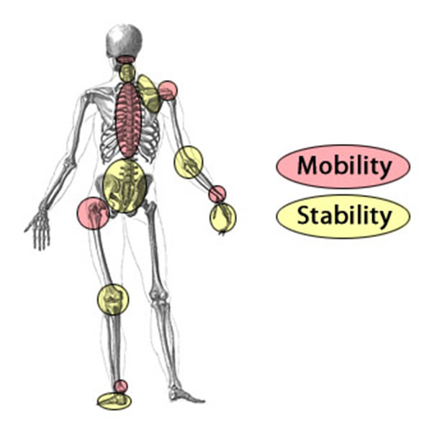
Joint by joint analysis

