Slide 1
Craig Liebenson
“Every exercise is a test and every test can be used to treat dysfunction”
Magnificent Seven
Range of motion of area of chief complaint
T4 postural mobility
Overhead squat
Single leg balance (eyes open/eyes closed)
Single leg squat
Lunge
respiration

Slide 2
Why warm up?
Injury prevention due to physical and mental “awakening”
  improved blood flow to muscle and tendons
  awakening of neural connections
Dynamic stretching provides performance improvements, static stretching and pnf does not provide any improvements¹
short-duration static stretching warm-up has no effect on power outcomes; and passive heating/cooling is a largely ineffective warm-up mode²
Acute effects of muscle stretching on physical performance, range of motion, and injury incidence in healthy active individuals: a systematic review.
A systematic review of the effects of upper body warm-up on performance and injury.
Notes:
if more troops are awake at the time of battle, you will have less casualties and better recruitment

Slide 3
Generalized Warm-up Routine:
Upper Body:
  Neck – look left and right (3x each side, 3-5 second hold)
  Neck – head rolls (3-5 passes each direction)
  Arms – cross arm swing (10-15 seconds)
  Arms – open and close gate (10-15 seconds)
  Arms – shoulder circles (each direction, 10-15 seconds)
  Trunk twists (10-15 seconds)
Lower Body:
  Hips – hip rotation (5-10 passes each direction)
  Knees and ankles – knee rotation (5-10 passes each direction)
  Ankles/calves – heel-toe rockers (20-30 seconds)
Notes:
Followed by:
200m-400m run
Air squats – 10
Pushups (may be modified) – 10
Hip thrusters/glute bridge – 15 both feet planted, then 10 one-legged

Slide 4
When do we start rehab?
IMMEDIATELY!
LATERAL CORTICOSPINAL TRACTS
  main motor tracts for voluntary muscle activity
  80-90% decussate to contralateral side
  10-20% do not decussate
Therefore, in theory, by voluntarily moving the unaffected side, we’re rehabilitating the affected side to some degree
Notes:
Physical Medicine and Rehabilitation Board Review, Third Edition
By Dr. Sara J. Cuccurullo, MD

Slide 5
The acute effects of targeted abdominal muscle activation training on spine stability and neuromuscular control
As a group, 5 min of ADIM training did not change spine stability during dynamic movement.
However, those who were most successful in improving TrA activation with a 5-min ADIM training session showed the greatest improvements in local dynamic spine stability after training. As such, dynamic spine stability in some individuals may benefit from ADIM training.
SOUTHWELL ET AL (2016), Journal of NeuroEngineering and Rehabilitation
Notes:
abdominal drawing-in maneuver (ADIM) standing – 13 “healthy” participants – once before and once after training
Indwelling and surface EMG and 3D kinematic data recorded during all trials
What does this tell us? Some people are more fit/have more body awareness than others. 5 minutes in one session may not be enough to rehab those that are deconditioned.

Slide 6
Overhead Deep Squat Performance Predicts Functional Movement Screen Score
Individuals categorized as low performance as a result of the DS test had lower adjusted FMS™ composite scores (p < 0.001). DS scores were positively correlated with adjusted FMS™ composite scores (ρ = 0.50, p < 0.001)
CLIFTON ET AL (2016), IJSPT
Notes:
International journal of sports physical therapy
What does this tell us? Deep squat is a great predictor of overall functional movement. FMS is important, but DS may be the most important screen out of the entire protocol.

Slide 7
The back squat: A proposed assessment of functional deficits and technical factors that limit performance
Squat movement pattern is most primal and critical fundamental movements needed to improve sports performance, reduce injury risk, and support lifelong physical activity
Essential ADLs utilizing squat: sitting, lifting, physical activity
Staple exercise to enhance performance and build injury resilience
Back squat is a preliminary test to assess neuromuscular control, strength, stability, and mobility in the kinetic chain
MYER, MCGILL, ET AL (2014), Strength Cond J
Notes:
Stu McGill
Back squat 1 and 2 – 1 assesses functional deficits, 2 proposes training techniques

Slide 8
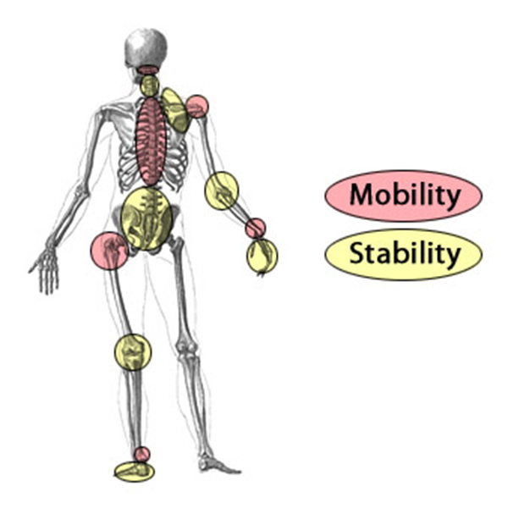
Joint by joint analysis

Slide 9
Treatment options
In the following slides I’ve highlighted the exercises I commonly use in practice and in the gym
Just because something is in black, it does not mean you will not have a patient that would not be able to do these exercises and vice versa
Exercises commonly used in the practice will be highlighted in gray with black text
Usually these exercises are the basics or a bit easier for patients
Exercises commonly used in the gym will be highlighted black with light gray text
Usually these exercises are harder or more complex

Slide 10
Head position: neuromuscular
Head tilt, return to neutral Identify neutral position “Slowly tilt chin” | BEAN BAG HEAD DRILLS Promote constant neutral position “Flat head” | GAZE TARGET DRILLS Disassociate head position from gaze “Keep eyes on target”

Slide 11
Head position: mobility
Flexion/extension Improve ROM sagittal “Chin to chest” | LATERAL FLEXION Improve ROM frontal “Ear to shoulder” | ROTATION Improve ROM transverse “Look over shoulder”

Slide 12
Head position: strength
Isometric head press: Flex/Ext Improve isometric strength “Firmly press head into hands” | Isometric head press: Lateral Improve isometric strength “Firmly press head against hand” | Shoulder shrug Improve cervical & scapular strength “Pull shoulders up to ears”

Slide 13
Thoracic position: neuromuscular
Scapular pinch Physical cue of retracting shoulders “Pinch my fingers with your shoulder blades” | Good morning Fortify chest up position “Lower torso forward while keeping chest up” | Squat with overhead press Improve chest up at apex of squat “Press dowel directly overhead”

Slide 14
thoracic position: mobility
Backward arm circles Improve pec & shoulder mobility “Slow, large controlled circles” | WALL SLIDES Improve shoulder mobility “Keep back on the wall” | SCAPULAR PRESS Correct lack of upward rotation “Press shoulders up and extend”

Slide 15
thoracic position: strength
BAND PULL APART Strengthen parascapular muscles “Keep arms straight” *Modified* | HIGH PULL Improve upper back strength “Pull straight up” | FRONT SQUAT Promote postural control “Lead with object during ascent”
NO

Slide 16
Trunk position: neuromuscular
Cat/cow Identify lordosis vs. kyphosis “Dip spine down and round spine up” | BALL WALL SQUAT Facilitate vertical trunk and encourage spinal curvature “Slide down the ball” | POLE SQUAT AND FIX Self-assist and correct deep hold position “Hold pole and fix”
NO

Slide 17
Trunk position: mobility
Standing back arch Improve hip flexor mobility “Push hips forward” | COBRA Improve trunk flexor mobility “Lengthen your abdomen” | CHATURANGA Improve trunk flexor mobility/core strength “Smoothly transition between each position”
Notes:
Chaturanga – downward facing dog, cobra, push-up, downward facing dog

Slide 18
Trunk position: strength
PLANK Improve isometric strength of core “Straight as an arrow” | SUPERMAN Strengthen lower back musculature “Raise chest and arms together” | OVERHEAD SQUAT Strengthen back and promote erect trunk “Keep the dowel behind your eyes”

Slide 19
Hip position: neuromuscular
SINGLE LEG HIP TILTS Identify even hip position “Even on hips” | SINGLE LEG SQUAT Maintain even hip position during more difficult task “Keep weight on heel” | BOSU/BALANCE BOARD SQUAT Maintain even hip position during more difficult task “Keep hips square”

Slide 20
Hip position: mobility
CROSSOVER STRETCH Stretch hip musculature “Press the knee towards the floor” | FIRE HYDRANT Improve lateral hip mobility “Keep back flat” | HIP CIRCLES Improve hip mobility “Draw a circle with your knee”

Slide 21
Hip position: strength
SIDE PLANK High recruitment of glute medius “Stack hips and feet” | SPLIT SQUAT Higher demand from hip musculature “Keep front shin straight” | DUCK WALKS Train glute med and glute max “Stay low with belly button pointing forward”

Slide 22
Knee position: neuromuscular
Wide stance squat Promote knee track over feet, avoid valgus collapse “Push knees outward” | BAND SQUATS Physical cut to push knees outward “Push knees outward” | SQUAT JUMP Promote knees apart when jumping “Land with knees apart”

Slide 23
Knee position: mobility
STANDING LEG SWINGS Improve hip adductor mobility “Isolate hip” | SIDE LUNGE (Great for adductors) Improve hip adductor mobility “Keep non-lunging leg straight” | CARIOCA Improve hip adductor and IR mobility “Maintain upright position”

Slide 24
Knee position: strength
SINGLE LEG ROMANIAN DEADLIFT Improve single leg knee stability “Make a T” | RUSSIAN HAMSTRING CURLS Improve eccentric hamstring strength “Lead with your hips when descending” | SINGLE LEG ISOMETRIC SQUAT AND HOLD Single leg knee stability “Point knee straight”
NO

Slide 25
Tibial angle: neuromuscular
LUNGE AND HOLD Identify correct tibial progression “Straight shin” | WALKING LUNGES Inhibit excessive tibial progression “Transfer bodyweight to back heel when moving forward” | WALL SQUAT Physical cue to prevent excessive tibial progression “Reach bottom away from heels”

Slide 26
Tibial angle: mobility
TOE TOUCHES Improve mobility of knee and hip “Reach for toes” | STRAIGHT LEG MARCH Improve mobility of knee and hip “Bring toes to straight arm” | LEG KICKS: FORWARD AND BACKWARD Improve hamstring and gluteal mobility “Swing toes to eye level”

Slide 27
Tibial angle: strength
STEP UP Ensure knee tracks in line with foot without excess tibial angle “Straight shin on ascent” | HEEL TOUCHES Unilateral leg strength, promote side to side strength symmetry “Press on box to ascend” | 1 AND ¼ SQUAT Strengthen vastus medialis at bottom of squat “Slow and controlled speed”

Slide 28
Foot position: neuromuscular
SINGLE LEG BALANCE Develop flat foot stability awareness, balance “Grip the ground with your toes and heel” | Y BALANCE Maintain foot on ground “Do not place pressure on tapping foot” | TOES-UP SQUAT Promote heel down mechanics “Lift toes off the ground”
NO

Slide 29
Foot position: mobility
ANKLE ROLLS Ankle mobility in three planes “Draw circles with the big toe” | STATIC CALF STRETCH Stretch gastroc and soleus “Press heel towards the ground” | HEEL WALKS Promote dynamic stability of calves “Point toes upward”

Slide 30
Foot position: strength
ANKLE BAND STRENGTHENING Strengthen ankle “Isolate ankle movement” | CALF RAISES Strengthen plantar flexors “Press down on balls of feet” | SINGLE LEG HOPS Promote single leg eccentric control “Soft landings”

Slide 31
descent: neuromuscular
WALL TAPS Instill hip hinge movement “Reach back for the wall” | TEMPO SQUATTING Fortify slow descent pace “Slowly lower to the box” | ASSISTED SQUATTING Assist in correct descent strategy “Sit to a chair”

Slide 32
descent: mobility
HURDLER STRETCH Stretch post. chain relative to squat “Reach past your toes” | HAMSTRING STRETCH TO SQUAT Stretch post. chain relative to squat “Slowly rise” | PIGEON POSE Intense posterior chain stretch “Reach forward”

Slide 33
descent: strength
ECCENTRIC FOCUSED KNEELING FALL Eccentric strengthen posterior chain “Lower as slowly as possible” | BOX DROP DEEP HOLD Dynamic, eccentric strengthen post. chain “Quiet landings” | PAUSE AT DESCENDING LEVELS Eccentric, isometric strength post. chain Signal 5 depth levels countdown “1-2-3-4-5”
NO

Slide 34
depth: neuromuscular
BOX SIT Identify correct depth “Sit up tall” | TACTILE/VERBAL CUE Identify depth while supporting weight Verbally cue correct depth | EYES CLOSED DEPTH Improve proprioception Verbally cue correct depth

Slide 35
depth: mobility
V STRETCH Stretch hip adductors “Spread legs until you feel a stretch and hold” | SUMO STRETCH Stretch hip adductors “Push out against knees” | FIGURE 4 STRETCH Stretch piriformis “Pull thigh to chest”

Slide 36
depth: strength
ASSISTED SQUAT HOLD Train isometric muscle action for depth “Reach buttocks away from heels” | POLE HOLD Train isometric muscle action for depth “Straighten shins and torso” | DEEP HOLD Train isometric muscle action for depth (no assistance) “Sit as if in a chair”

Slide 37
ascent: neuromuscular
GLUTE BRIDGE Emphasize hip drive (static) “Hips to the ceiling” | HIP THRUSTS Emphasize hip drive (dynamic) “Hips to the ceiling” | BALL LEAD SQUAT Promote leading with chest “Lead with the ball”

Slide 38
Ascent: mobility
LUNGE HIP FLEXOR STRETCH Hip flexor, T/S stretch “Lean back” | DONKEY KICKS Hip flexor mobility relative to squat “Plant footprint on the ceiling” | SCORPION Stretch lower back, gluteus, hamstring “Keep chest on the ground”

Slide 39
ascent: strength
BOX SIT TO STAND Promote hip drive & push through heels “Press down on heels, use hips to stand” | VERTICAL COUNTER-MOVEMENT JUMP Train using explosive exercise post. Chain “Explode upward and use soft landings” | SUMO DEADLIFT Strengthen post. chain, postural control “Keep chest up, press down on heels, through with hips”

Slide 40
Typical LBP patient
WEEK 1
  Mobility – knee to chest, iron cross
  NMS – Chair rocker, cat/cow
WEEK 2
  Mobility – continue “elementary stretches” or graduate to specialized stretches
  NMS – Cross Crawl
  Strength – plank or the bear, side plank
WEEK 3
  Functional Door Squat
Notes:
May progress faster, modify as needed

Slide 41
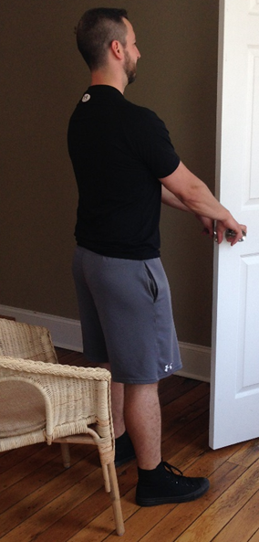
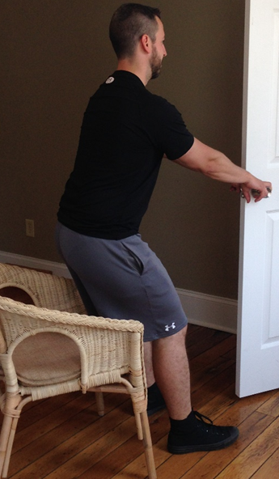
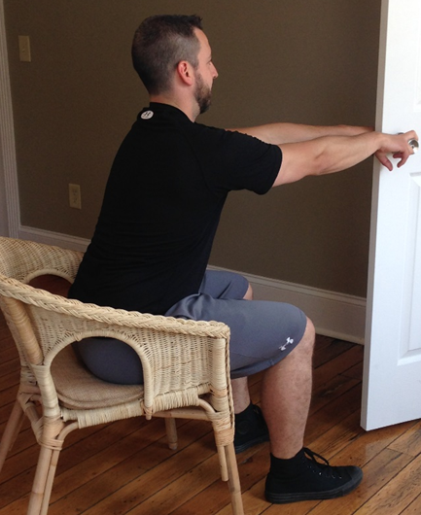
Functional Door Squat

Slide 42
Functional Door Squat
Feet: shoulder width apart, externally rotated 0-10°
Body position: arm’s length from door
Chair height: just below the patellae
Tips:
Unhinge hips – “Push your butt back first”
Eyes forward
Don’t let knees adduct – “Keep pushing your knees out”
Don’t come up on the toes – “push through the heels”

Slide 43
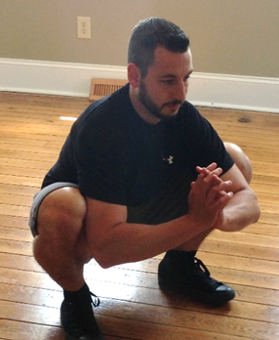
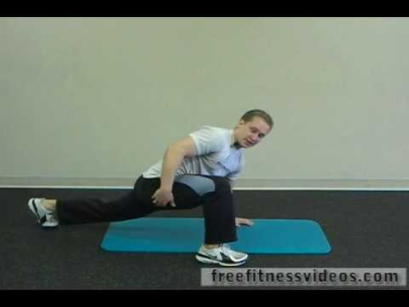
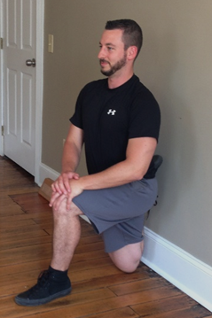
Specialized Squat Stretches
Squat hold Spiderman stretch Couch stretch
Stretch adductors and hip flexors
Stretch hip flexors
Stretch adductors
Notes:
https://www.mobilitywod.com/propreview/couch-stretch-tight-hips-dont-go-in-the-pain-cave-mobility-project-episode-2/

Slide 44
Mcgill: the big 3 for core stability
Perform as isometric exercises working up to multiple sets of 10 second holds
Modified curl up
  Greater activation of anterior core stabilizers
Side Plank
  Greater activation of glute medius and QL (lateral core)
Bird Dog/Cross-Crawl Pattern
  Greater activation of posterior core (lumbar multifidus)
Notes:
May progress faster, modify as needed

Slide 45
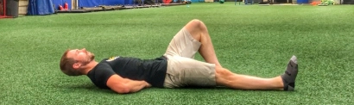
curl up
NOT the typical sit-up/curl
Start supine and bend the knee on one side
  With radiculopathy, bend the affected side knee
Place hand in lumbar lordosis to ensure there is no extra movement
Lift head off of the ground approximately 3-5 inches
The lordosis should not increase or decrease
Descending reps – 6 reps, 4 reps, 2 reps
Notes:
Specific lumbar injury will help identify the atrophied multifidus → L3/L4 herniation tied to L4 multifidus atrophy
Splinting of larger muscles leads to disuse of multifidus
3 days → up to 30% reduction

Slide 46
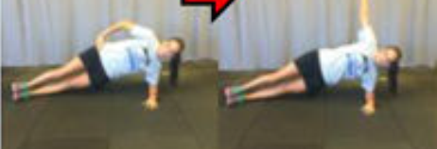
Side plank
Lying on the side, elbow bent to 90 degrees, arm abducted to about 90 degrees
“Stiff as a board” for 10 seconds
Descending sets – 6 reps, 4 reps, 2 reps
Notes:
Specific lumbar injury will help identify the atrophied multifidus → L3/L4 herniation tied to L4 multifidus atrophy
Splinting of larger muscles leads to disuse of multifidus
3 days → up to 30% reduction

Slide 47
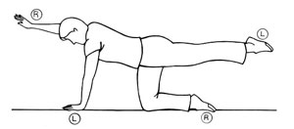
Cross-Crawl exercise
Non-specific LBP leads to atrophy/deactivation of lumbar multifidus muscles
Cross-crawl awakens neural connection and allows hypertrophy of lumbar multifidus muscles
Progression: Dead bug, kneeling CC, plank CC
Notes:
Specific lumbar injury will help identify the atrophied multifidus → L3/L4 herniation tied to L4 multifidus atrophy
Splinting of larger muscles leads to disuse of multifidus
3 days → up to 30% reduction

Slide 48
Typical upper crossed patient
WEEK 1
  Mobility – Yes, No, Maybe; head rolls; pec stretch
  NMS – positional awareness, chin retraction
WEEK 2
  Mobility – continue “elementary stretches” or graduate to specialized stretches
  NMS – Bruegger’s, lower trapezius activation
  Strength –scapular pinch throughout squat
WEEK 3
  Wall angels

Slide 49
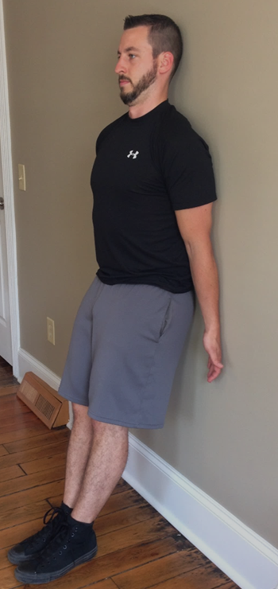
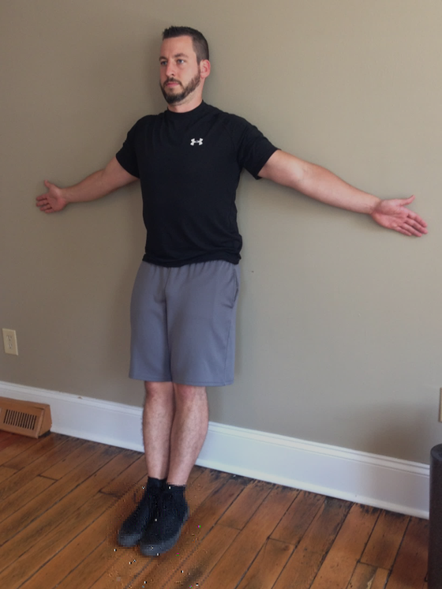
Wall Angels

Slide 50
Wall Angels
Feet: About 6” from the wall, hip width
Body position: post pelvic tilt, lower trapezius contract, chin tucked, arms in anatomic neutral starting at side → raise arms laterally until form fails, lower to just below breaking point and hold
Tips:
Post. Pelvic tilt – “squeeze your abdominals, flatten your back”
Lower trap – “pretend you’re holding a pencil between your shoulder blades”
Be patient – rushing will often cause bad form

Slide 51
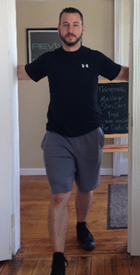
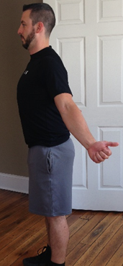
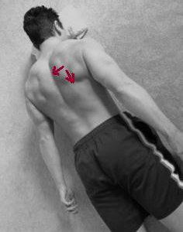
Specialized Wall Angel Exercises
Pec stretch lower trap strengthen bruegger’s

