Slide 1
Structural Short Leg
Apparent leg Length Test:
Umbilicus to medial/lateral malleolus
  True (Actual) Leg Length Test:
  ASIS to medial/Lateral malleolus

Slide 2
Structural Short Leg
Allis Test: Supine, knees bent, feet aligned.
Compare evenness of knees.

Slide 3
If one knee extends past the other = short femur on the short side.
If one knee is higher than the other = short tibia on the low side.

Slide 5
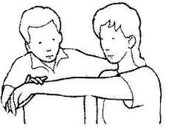
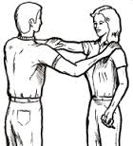
Functional Muscle Testing
Gives a perception of relative strength of the muscle based on amount of force applied.
Test patient: unsupported, w/orthotics, orthotics in shoes.

Slide 6
Spinal Cord X-Section

Slide 7
Functional Muscle Testing

Slide 8
Neurological Explanation
Nociceptors (pain receptors) send impulses to the spinal cord causing Pre- Synaptic Inhibition of the anterior horn cells.
This produces 7-10 seconds of muscle weakness upon resisted testing.

Slide 9
A corrective force into the misaligned area will reduce nociceptor activity.
Pre-Synaptic Inhibition is thereby decreased
eliminating the 7-10 seconds of muscle weakness
Thus muscle strength is increased.

Slide 10
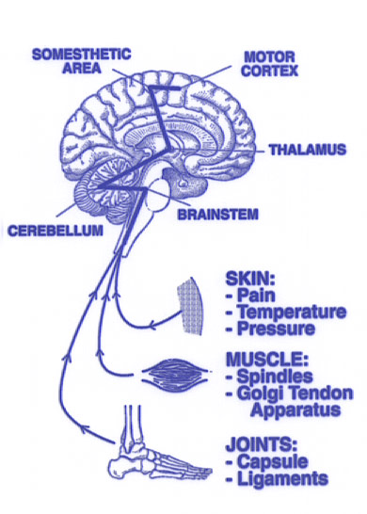
Structural stress produces muscle imbalances as a result of nerve dysfunction

Slide 11
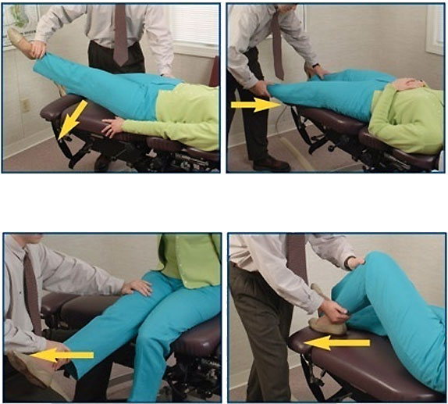
Medial Longitudinal Arch
Lateral Longitudinal Arch
MANUAL
MUSCLE
TESTING
Iliopsoas
Gluteus Medius/Minimus
Anterior Transverse Arch
Quadriceps & Hamstrings

Slide 12
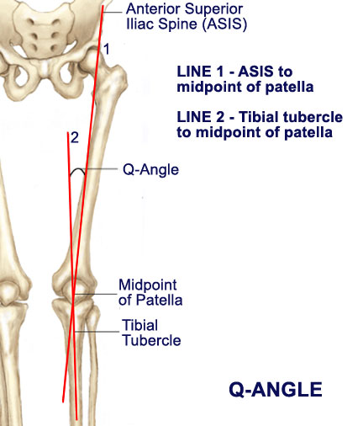
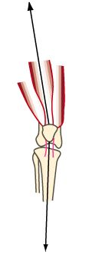
Notes:
2002 Sept Vol. 25 #7 Q-Angle and Patellar Tracking Study

Slide 13
Treatment - ASR Principle
1. Adjust
2. Stabilize
3. Rehabilitation

Slide 14
The Chiropractic Paradigm
…preserve and restore health.
…the body’s innate recuperative power is controlled by the nervous system.
…structural balance and neurological function.
    The Association of Chiropractic Colleges, Position Paper The ACC Chiropractic Paradigm, July 1996.

Slide 15
According to the ACA, the most frequently used techniques by DC’s are:
Diversified 95.9%, Activator Methods 62.8%,Gonstead 58.5%, Cox Flexion/Distraction 58.0%, Thompson 55.9%, SOT 41.3%, AK 43.2%, Extremity adjusting 41.3%, NIMMO/Receptor Tonus 40.0%, Cranial 37.3%, Adjustive Instruments 34.5%, Palmer upper cervical (HIO) 28.8%, Logan Basic 28.7%, Meric 19.9%, and Pierce-Stillwagon 17.1%

Slide 16
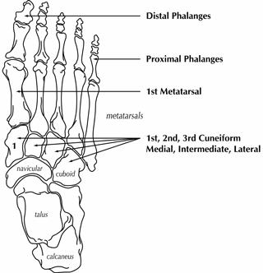
Adjusting the feet

Slide 17
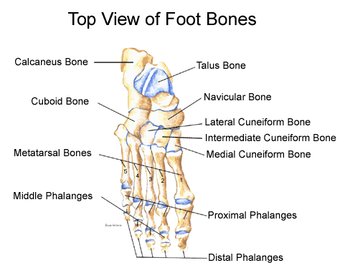
Adjusting the Foot
Navicular
Cuboid
Talus
Calcaneus
Metatarsals
Phalanges

Slide 18
Types of Adjusting
Manual/Diversified
Drop table
Spring Loaded Instrument
Notes:
For children or elderly, even light force applied in a specific direction will help you correct the alignment of the bone.

Slide 19
Drop Table TIPS
Watch your tension!
Inhale/exhale for comfort
Mind your spinal contours

